Slide 1
Intelligent Irrigation System
Team Pirates of MIST
Abtahi Ishmam
Mahmudul Hasan
Koushik Roy

Slide 2
Objective
The development of an intelligent irrigation system.
System Features
Capture data from soil moisture, rain and light sensors.
Determine required amount of irrigation from received data.
Initiate irrigation automatically according to requirement.
Automatically open flood gates to release excess water.

Slide 3
Equipment
Arduino Mega - 1
LM298N - 1
LCD Display - 2
Servo Motor – 2
Sonar Sensor – 2
Soil Moisture Sensor – 2
Water Pump Motor – 1
Lipo Battery - 2

Slide 4
System Architecture
SONAR1
ARDUINO &
LIPO BATTERY
WATER PUMP
WATER PIPE
LCD1
LCD2
TEST SOIL
SOIL MOISTURE SENSOR
INTELLIGENT IRRIGATION SYSTEM
SONAR2

Slide 5
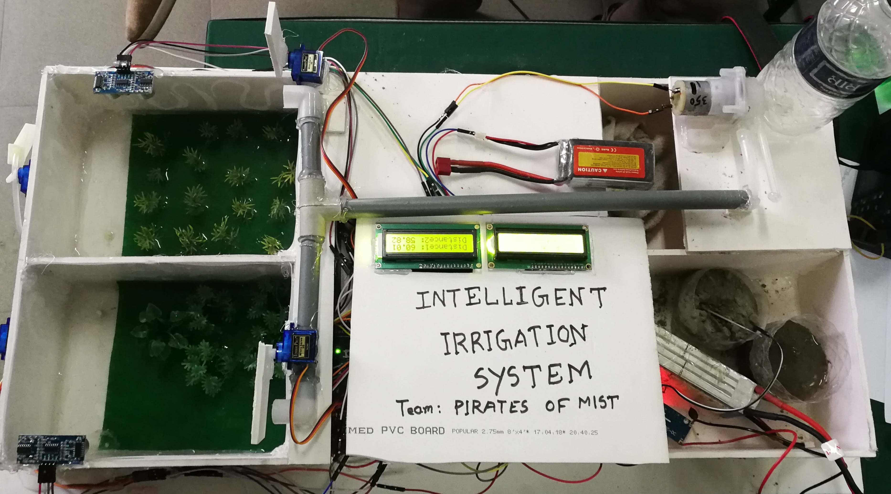
Completed System

Slide 6
Code
GitHub Link: https://github.com/abtahiishmam3/smart_irrigation/blob/main/code.ino

